Slide 1
Classes - Design Patterns
Phil Pfeiffer
April 2013
Key Source: Barrett course notes, CSCI 5300, spring 2010

Slide 2
Design Patterns - Definition
"Medium-level" strategy for recurring design problem
▪ Builds mechanism from multiple constructs from target language, because target language has no one construct for handling problem
▪ Depicts relationships, information flow among constructs
What counts as pattern varies by language
▪ assembler, F77 - while loops a design pattern!
▪ built from if's, goto's
▪ C - objects a design pattern
▪ object-based design

Slide 3

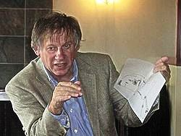
Design Patterns in OO - Origins
Two inspirations for work on design patterns
Jim Coplien, Advanced C++ Programming Styles and Idioms, 1991
  Catalogue of strategies for coding in C++
Christopher Alexander, A Pattern Language: Towns, Buildings, Construction
  250 patterns for developing architectures

Slide 4


OO Design Patterns -
Seminal Work
Design Patterns: Elements of Reusable Object-Oriented Software
Erich Gamma,
Richard Helm,
Ralph Johnson,
John Vlissides
a.k.a. "Gang of Four" (GoF)
published 1995

Slide 5


OO Patterns - GoF
Identified 23 ways of assembling classes for recurring design problems
Divided patterns into three categories
▪ Creational - object instantiation
▪ Structural - composing structures
▪ Behavior - algorithms and processes, including communications
Standard format for presentation
Intent, Aliases, Motivation, Applicability, Structure, Participating patterns, Collaborations, Benefits and liabilities, Implementation, Sample code (C++), Known uses, Related patterns

Slide 6
Influence: Enormous
▪ Porting of patterns to other OO languages (Java, C#, …)
▪ Pattern conferences
▪ Software
▪ Teaching and pedagogy
▪ Pattern websites (tons: e.g., http://www.oodesign.com/)
▪ Books
▪ 1,448 hits on Amazon.com for "software patterns"
▪ in my library alone
▪ Head-First Design Patterns
▪ Pattern-oriented Software Architecture, Volumes 1, 2, 3, 4
▪ Real-time Design Patterns
▪ Enterprise Integration Patterns
▪ Anti-Patterns: Refactoring Software, Architectures, and Projects in Crisis
▪ SQL Anti-Patterns
▪ Focus here: original 23

Slide 7
Goal: Motivate using Examples
Present patterns in ways that try to make their use apparent
Strategy: apply patterns to "interesting" domain that I haven't seen addressed in literature
  Standard domain: gaming
  Here: systems administration and access

Slide 8
Creational Patterns
Singleton
Builder
Prototype
Factory method
Abstract factory

Slide 9
Singleton
Scenario
▪ several clients need instances of object
▪ object is single, shared entity
Solution
▪ create object on first request, if not present
▪ provide reference to object on all requests
Trivial in languages that provide classes with static methods and data

Slide 10
Singleton: Examples
Access to physical resources
  Hosts
  Printers
Access to logical resources
  Servers
  Databases

Slide 11
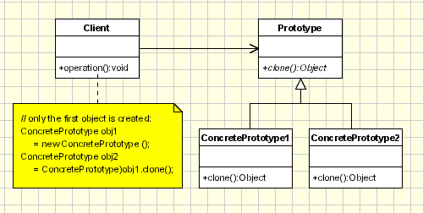
Prototype
Use sample object as basis for creating new objects:
e.g., duplicating room layouts in a simulated building
▪ Ask object to create and return duplicates of itself
Payoff: client can remain ignorant of prototype particulars
Copy constructor with copy of internal state?

Slide 12
Prototype: Further Examples
One-step configuration
For a specific sort of account: e.g.,
SQL Server/ Oracle logic for a given level of
database access
For a specific sort of application: e.g.,
local config files for an XWindows host
For a specific host: e.g.,
permissions for a user PC

Slide 13
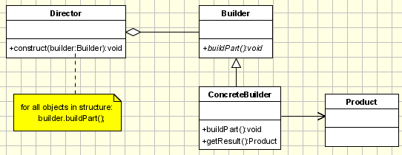
Builder
Create a complex object from a set of part types whose specific implementations may vary
▪ e.g., a facial image from a skull structure, eyebrow type, eye color, nose type, ear type, mouth type, and hair type
Client creates director, supplies director with builders

Slide 14
Builder: Further Examples
Multi-step configuration
For an account with an entity that
  hosts multiple resources, where
  users get different permissions for different resources
    entity is a DB; resources are datasets
    entity is an app server; resources are apps
For an instance of an application that
  supports multiple plug-ins, where
  instances require different plug-ins for different environments
    entity is an extract-transform-load app; plug-ins
    support transfer for different source, target hosts

Slide 15
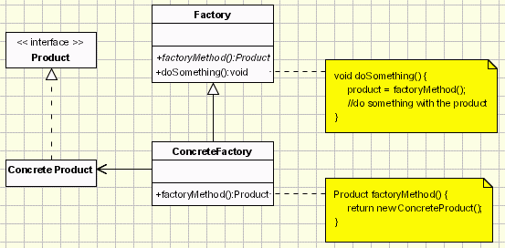
Factory Method
Allows client class to postpone determining what objects to create until run-time
Example: create hostile AIs whose action is determined dynamically by a game at run-time, based on a player's skill level

Slide 16
Factory Method: Further Examples
Runtime-environment-dependent report generation
For an application that generates
  different types of snapshots of current system activity, based on
  the load on a system at the time when the snapshot is taken (i.e., more load => less detail)
For an application that generates
  different types of "anomalous event" reports from a system log, based on
  what patterns of events the application discovers

Slide 17
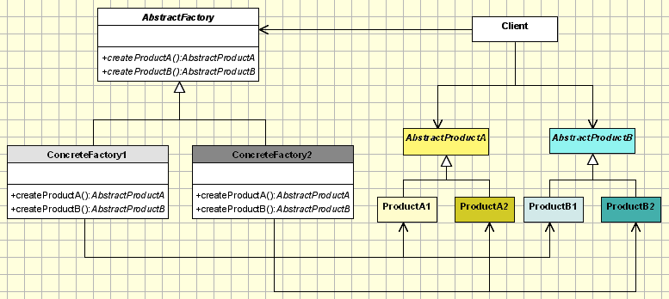
Abstract Factory
Create related sets of objects whose implementation is determined at run time (e.g., objects in a maze game)

Slide 18
Abs. Factory Method: Further Examples
Platform-dependent real-time intrusion detection
For an application that
  spawns different applications for checking for tampering with key system resources
    init parameters dataset (i.e., registry, /etc/whatever)
    file system
    firewall configuration
    process table
  based on host operating system type

Slide 19
Discussion: Creational Methods
Two common strategies for parameterizing systems by classes of objects it creates
▪ Subclass the creator class (e.g., Factory Method)
▪ Often used as starting point for object creation, due to simplicity
▪ Pass a class that knows how to compose objects
as a parameter to the system
(e.g., Abstract Factory, Builder, prototype)
▪ More flexibility with more complexity

Slide 20
Structural Patterns
Adapter
Façade
Bridge
Composite
Decorator
Proxy
Flyweight

Slide 21
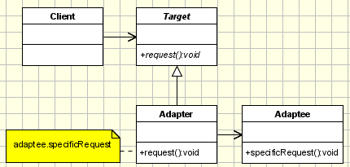
Adapter
Problem: server, client use different protocols; server must be used as-is
▪ e.g. wrapping legacy code, third party library
Solution: adapter rewrites client call for server
▪ could be as simple as re-ordering parameters
▪ could be more complicated, e.g. do some computation first

Slide 22
Adapter: Examples
Cross-platform APIs
Samba
  Windows SMB protocol for Unix
ODBC
  Open DataBase Connect
  Supported by various commercial DBs
Virtual machine models of underlying platforms
  Python
  Java

Slide 23
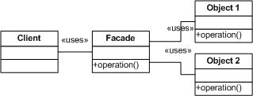
Façade
Uses:
Simplify subsystem use by providing a simplified interface to a complex subsystem
Decouple subsystem from client system by routing all dependencies through one interface
Support layering of subsystems, for maintainability

Slide 24
Façade: Examples
Certain language-based file system APIs
(e.g., classic C++, XSLT)
Don't model file attributes
Don't model update in place

Slide 25
Adapter vs. Façade: Comments
Historically, known as
  Wrapper classes
  Isolation layers
Classic need in systems integration
  Have heard people say they've spent much of their careers writing these
Main difference
  Adapter re-presents an underlying API
  Façade deliberately simplifies it

Slide 26
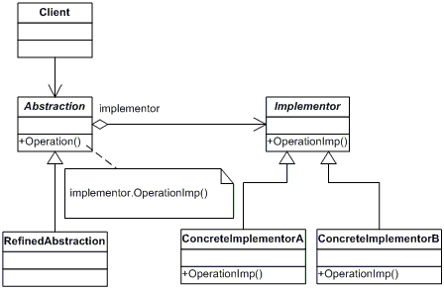
Bridge
Allow client to choose from among several models at run time, where models have different implementations
Separate inheritance hierarchy for model, implementation

Slide 27
Bridge
Allow client to choose from among several models at run time, where models have different implementations
Separate inheritance hierarchy for model, implementation

Slide 28
Bridge
Allow client to choose from among several models at run time, where models have different implementations
Separate inheritance hierarchy for model, implementation

Slide 29
Bridge: Examples
Implementing data persistence
Supporting different requirements for formatting
  markup, csv, binary…
With different mechanisms
  databases, flat files, off-line storage
Implementing authentication
Supporting different requirements for authentication
  strength-speed tradeoffs
With different mechanisms
  biometrics, tokens, challenge (i.e., passwords)

Slide 30
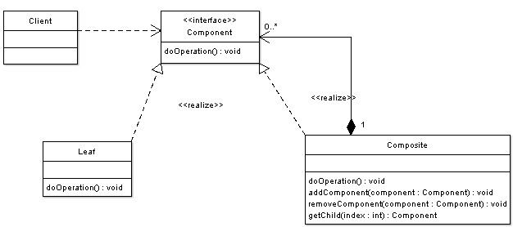
Composite
Create hierarchy of subassemblies that acts as a single, composite object.

Slide 31
Composite
Note 0..* multiplicity
Create hierarchy of subassemblies that acts as a single, composite object.
Subassemblies can have varying number of parts

Slide 32
Composite
Note 0..* multiplicity
Create hierarchy of subassemblies that acts as a single, composite object.
Subassemblies can have varying number of parts
Example: subassemblies are nested drawings with line, ellipse, rectangle, etc. leaf elements; doOperation() is render

Slide 33
Example: Composite Representation of an Image (courtesy Dr. Barrett)
picture
line
ellipse
picture
abc
rectangle
picture
circle
text

Slide 34
Composite: More Examples
Structuring a process table for a system where
Processes vary dynamically (i.e., standard OSes)
Processes can nest, e.g.:
  Processes can fork other processes
  Threads and fibers are treated as subprocesses

Slide 35
Builder vs. Composite
Both compose objects
How they differ
  Builder composes static objects
  Composite composes dynamically varying objects
  Builder can be used to instantiate compositions

Slide 36
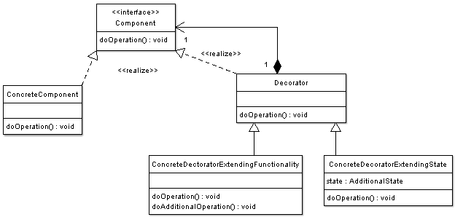
Decorator
Like composite, but with just one object attached at each level of hierarchy (i.e., a list)

Slide 37
Decorator
Like composite, but with just one object attached at each level of hierarchy (i.e., a list)

Slide 38
Decorator
Like composite, but a list
Decorators are active, not passive (as in composite); each adds functionality - e.g., a widget to a GUI
Order in list matters if some decorators depend on others (e.g., scroll bar must sit atop viewing field)

Slide 39
Decorator: More Examples
Log-structured file systems, which store files as
  Base datasets, together with
  Series of changes to those datasets
Artifact versioning systems, like CVS and SVN
Pipelines

Slide 40
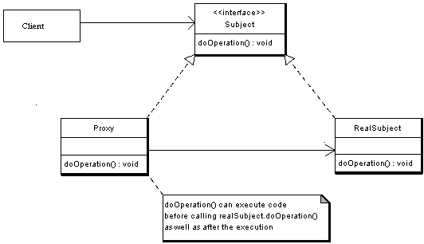
Proxy
Intermediary class controls access to real class
Can preprocess requests, post-process responses

Slide 41
Proxy: Examples
Proxy servers!

Slide 42
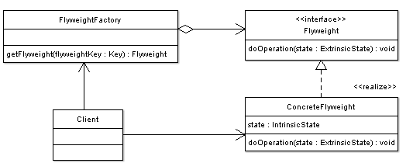
Flyweight
Allow sharing of state within groups of related objects
Concern: reducing memory demands for large pools of objects
Examples
▪ game AIs: share image (intrinsic); keep health, location local (extrinsic)
▪ text chars: share image (intrinsic); keep location in text, point size local

Slide 43
Flyweight: More Examples
Threads: loci of control that share common file descriptors, process characteristics
reduces overhead of context switching
increases vulnerability of one loci of control to another's aberrant behavior

Slide 44
Discussion: Structural Methods
▪ Adapter vs. Bridge
▪ Adapter: resolves incompatibilities with existing interfaces
▪ makes logic work after components are designed
▪ Bridge: provides stable interface with flexible implementations
▪ used before components are designed to make logic work
▪ Adapter vs. Façade
▪ Adapter: reuses existing interface
▪ Façade: defines new, typically simplified interface
▪ Composite vs. Decorator vs. Proxy
▪ Composite - focuses on structuring classes (representation)
▪ Decorator - adds responsibilities to assembly without subclassing
▪ Focuses on embellishment
▪ Proxy - focuses on stand-in for another, possibly remote object

Slide 45
Behavioral Patterns
Template Method
Memento
State
Strategy
Iterator
Mediator
Observer
Chain of Responsibility
Visitor
Command

Slide 46
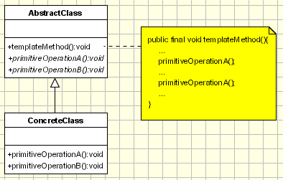
Template Method
B( );
Define an algorithm's skeleton in an abstract class, deferring some steps to subclasses
Well, d'oh,…

Slide 47
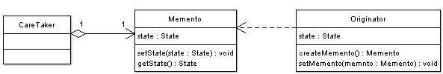
Memento
Capture an object's state for later restoration
a.k.a. serialization, checkpointing

Slide 48
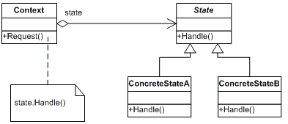
State
▪ Allow method behaviors to vary dynamically based on status of computation (e.g., networked communications)
▪ Context holds multiple states
▪ Handler method(s) behavior(s) differ by state
▪ Either context or concrete states identify state switches

Slide 49
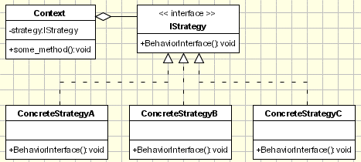
Strategy
Allow algorithm's implementation to change, based on run-time considerations
(anything from sort routines to AI behavior)
Also straightforward

Slide 50
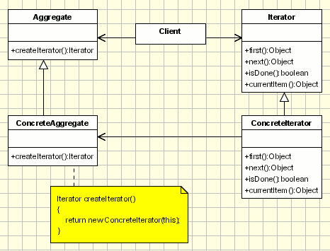
Iterator
Return each object in a collection, hiding collection's structure
▪ External: sequence controlled by collection
▪ Internal: sequence controlled by iterator - i.e.,
collection uses iterator-supplied routine to stream objects
Common in modern languages

Slide 51
State, Strategy, Iterator: Examples
State – the classic pattern for protocol implementation
Strategy – one way of supporting graceful degradation under load: e.g.,
  Reducing priority of long-running processes
  Changing criteria for admitting processes to job queues
Iterator – common for system APIs that allow users to examine collections of system objects: e.g., files, processes, users

Slide 52
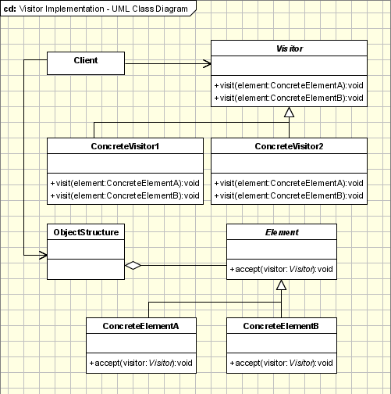
Visitor
Apply action to disparate elements without changing elements' code
Idea:
▪ Define abstract operation with concrete implementations in visitor class visit() method
▪ Define accept() method in elements that
▪ applies visitor object's visit method to
▪ element's internal state
Example: collecting word use statistics across different document types

Slide 53
Visitor: Examples
Collecting information common to multiple systems in a facility with heterogeneous systems
resource usage
  by resource type
  by job type
  by user
event data
  failed login attempts
  failed port accesses

Slide 54
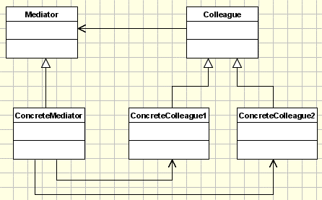
Mediator
Hide interaction protocol for accessing set of colleague classes based on an interface (mediator) with an implementation
Differences with façade:
  Intended for communication, rather than mask underlying API
  supports cooperative behavior (not unidirectional communication)
Example: high-level interfaces to low-level I/O libraries (files, sockets)

Slide 55
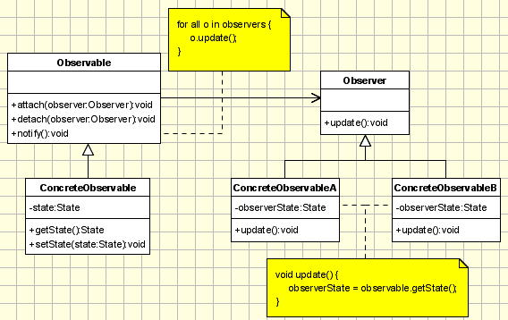
Observer
Like publish-subscribe style, within a single application
▪ Observable contacts observers to notify them of events
▪ Decouples operation of observable, observer (e.g., for concurrency)
Observable called "subject" in GoF

Slide 56
Mediator vs. Observer: Observations
vs. proxy
  ▪ Serve collections of entities
  ▪ Support dynamic membership in collections
vs. each other
▪ mediator centralizes communication, simplifying it
▪ chat-room-like / CSCW-like communication
▪ observer distributes communication,
promoting reuse (and, potentially, concurrency)
▪ RSS-like communication

Slide 57
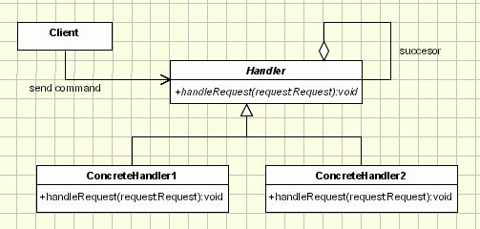
Chain of Responsibility
Allow a request to be serviced by a dynamically varying set of handlers
Example: vary handlers for mouse clicks

Slide 58
Chain of Responsibility: Observations
Hard, offhand, for me to think of use of CoR in system environment!
Seems most useful when events that trigger actions could be managed by two or more handlers: e.g.,
  While CoR could be used to implement Windows Explorer's OPEN command, a map from .ext's to apps seems a lot more efficient
Perhaps useful for load balancing?
  Hand massive job from system to system until one system accepts job?

Slide 59
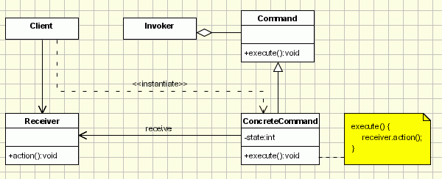
Command
Allow agent (invoker) to request execution of a command, while remaining ignorant of format, and possibly semantics (e.g., redo)
Idea
▪ Client creates command, stores command in invoker
▪ Invoker invokes command at need

Slide 60
Command: Examples
Classic use: do/ undo/ redo
Store successive actions as linked list
Traversing linked list gives undo (backwards),
redo (forwards)

Slide 61
Discussion: Behavioral Patterns
"With few exceptions", behavioral design patterns complement one another - and other patterns
Some encapsulate varying behavior
▪ algorithms (strategy)
▪ state-dependent behavior (state)
▪ usage protocols (mediator)
▪ collection traversal (iterator)
All four remove "hard-wired" behavior from objects

Slide 62
Discussion: Behavioral Patterns
Four patterns decouple senders and receivers
▪ command - simple interface for issuing a request
▪ observer - loosely coupled protocol for signaling changes in subjects; best suited for managing data dependencies between objects
▪ mediator - routes requests from client to back-end objects
▪ chain of responsibility - passes request thru chain of
potential receivers

Slide 63
Discussion: Patterns
Well-designed OO systems have multiple embedded patterns - though not necessarily because designers thought in these terms
How they can help designers
▪ Providing common vocabulary for design
▪ Reference for learning and documenting work, including explaining the "why" of one's designs
▪ Supporting work of improving code quality ("refactoring") by providing possibilities for improving code
Abundance of documentation on web

